Slide 1





Spin demons in $d$-wave altermagnets
Pieter Gunnink
pgunnink@uni-mainz.de
09.05.2025
Gunnink, Sinova, Mook, arXiv:2504.11062

Slide 2

Spin demons in $d$-wave altermagnets
Pieter Gunnink
pgunnink@uni-mainz.de
09.05.2025
Gunnink, Sinova, Mook, arXiv:2504.11062

Slide 3

Plasmon versus Pines‘ demon
Plasmon
Pines, Bohm, Phys. Rev. 85, 338 (1952)

Slide 4
Plasmon versus Pines‘ demon
Band 1
Band 2
Plasmon
Pines, Bohm, Phys. Rev. 85, 338 (1952)

Slide 5
Plasmon versus Pines‘ demon
Band 1
Band 2
Requires bands with different Fermi velocities
Distinct electron motion – on (Demon)
Pines, Can. J. Phys. 34, 12A (1956)

Slide 6
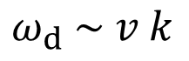
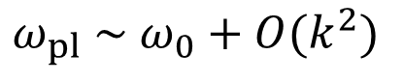
Plasmon v Pines‘ demon
Plasmon
Demon
disturbes charge density
couples to light
does not disturb charge density
does not couple to light
$$ω_{pl} \sim ω_{0}+O(k^{2})$$
$$ω_{d} \sim v k$$
Pines, Bohm, Phys. Rev. 85, 338 (1952)
Pines, Can. J. Phys. 34, 12A (1956)
Observation: Husain et al., Nature 621, 66–70 (2023)

Slide 7
Plasmon v Pines‘ demon in a magnet
Plasmon
Spin Demon
disturbes charge density
does not disturb spin density
does not disturb charge density
disturbes spin density
$$ω_{pl} \sim ω_{0}+O(k^{2})$$
$$ω_{d} \sim v k$$
Agarwal et al., PRB 90, 155409 (2014)

Slide 8
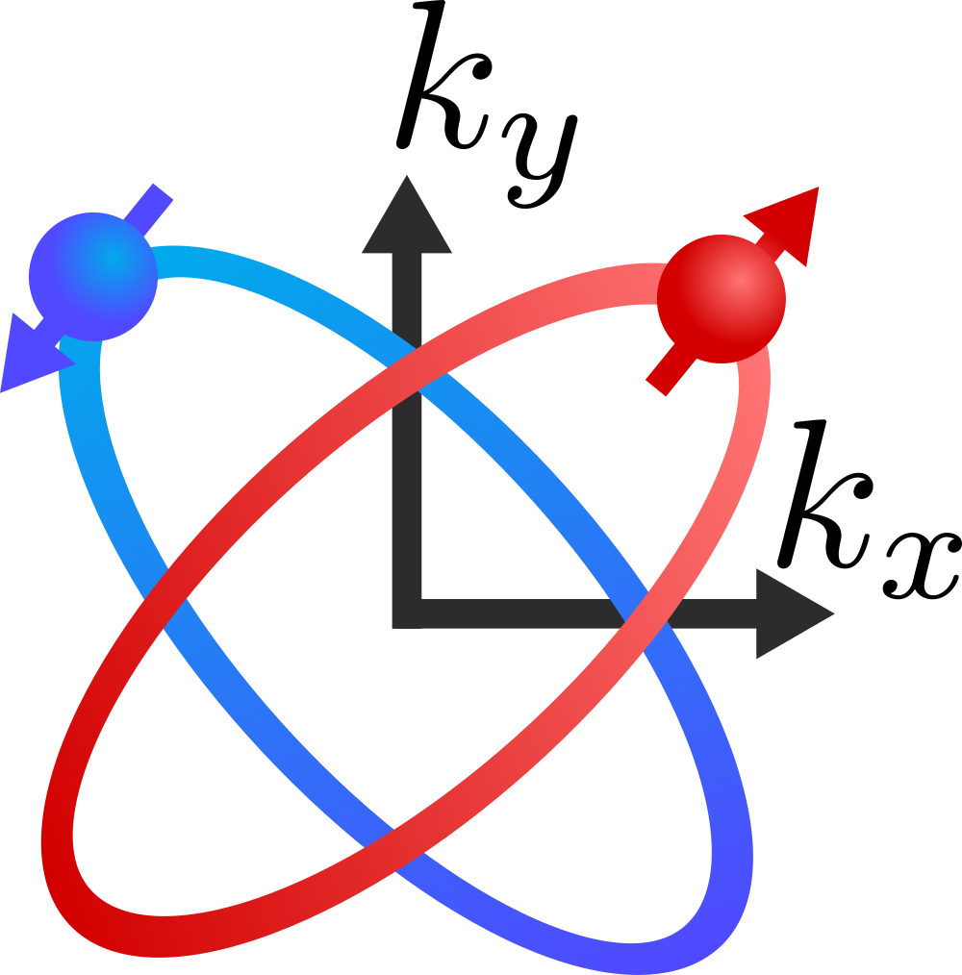

Spin demon in $d$-wave altermagnet
Spin Demon …
… in Altermagnets

Slide 9
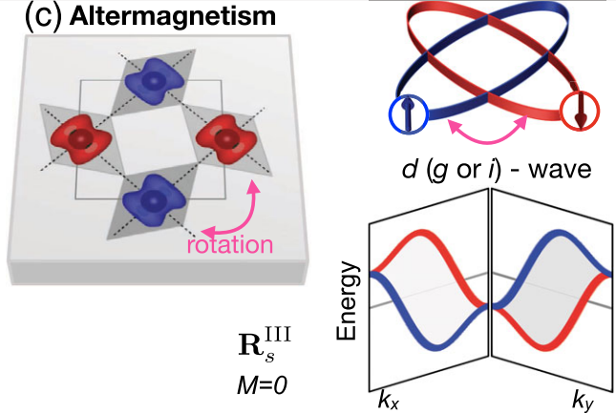
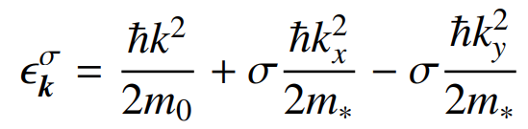
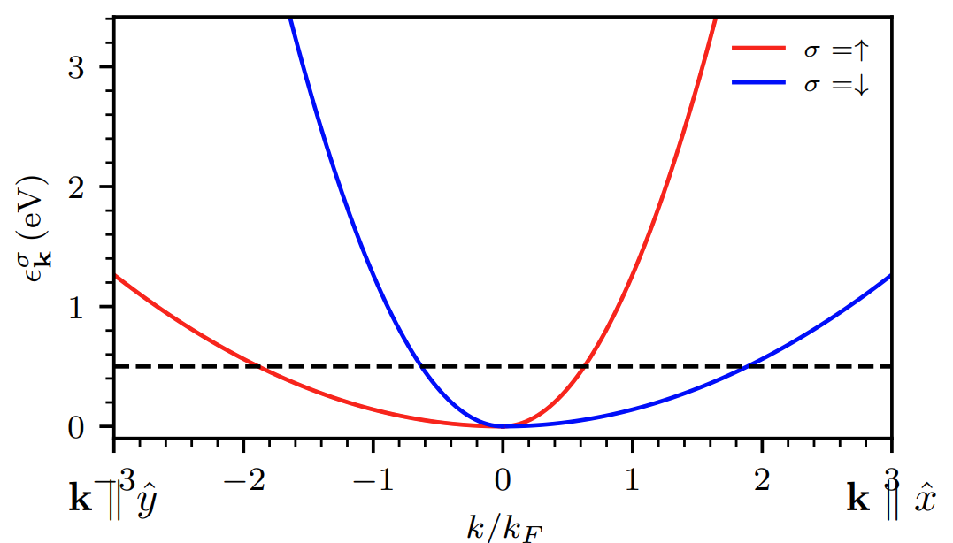
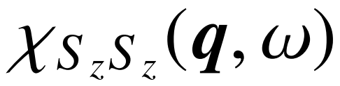
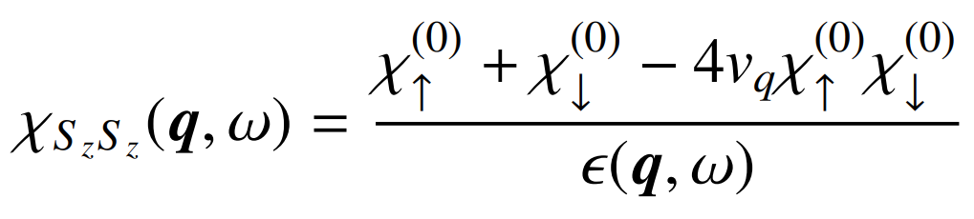
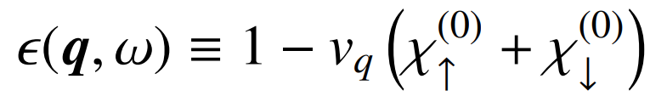
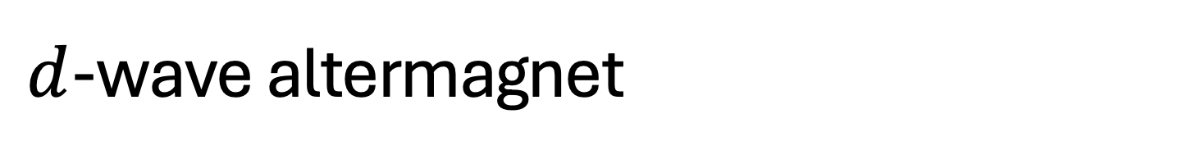
$d$-wave altermagnet
Carry out RPA for

Slide 10
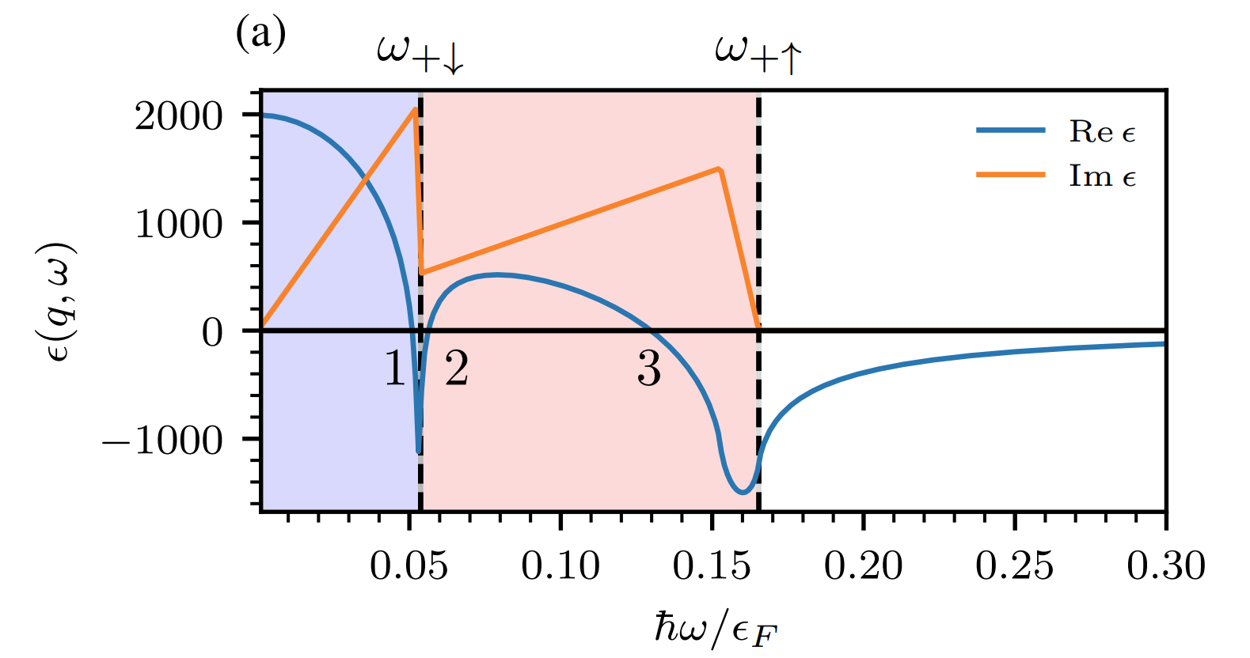

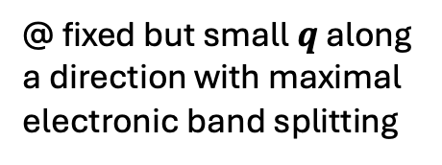
Dielectric function
Spin-resolved edge of Particle-hole contuum
Zeroes of $ε(q,ω)$ determine collective modes
@ fixed but small$q$ along a direction with maximal electronic band splitting

Slide 11
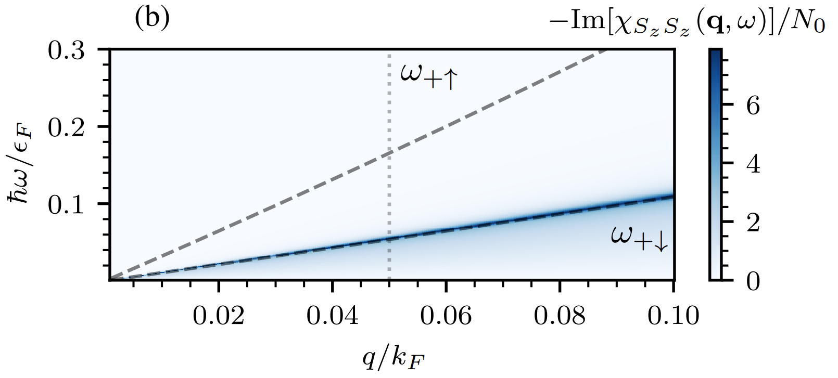
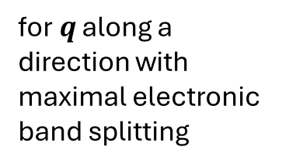
Spin demon in d-wave altermagnet
for$q$ along a direction with maximal electronic band splitting

Slide 12
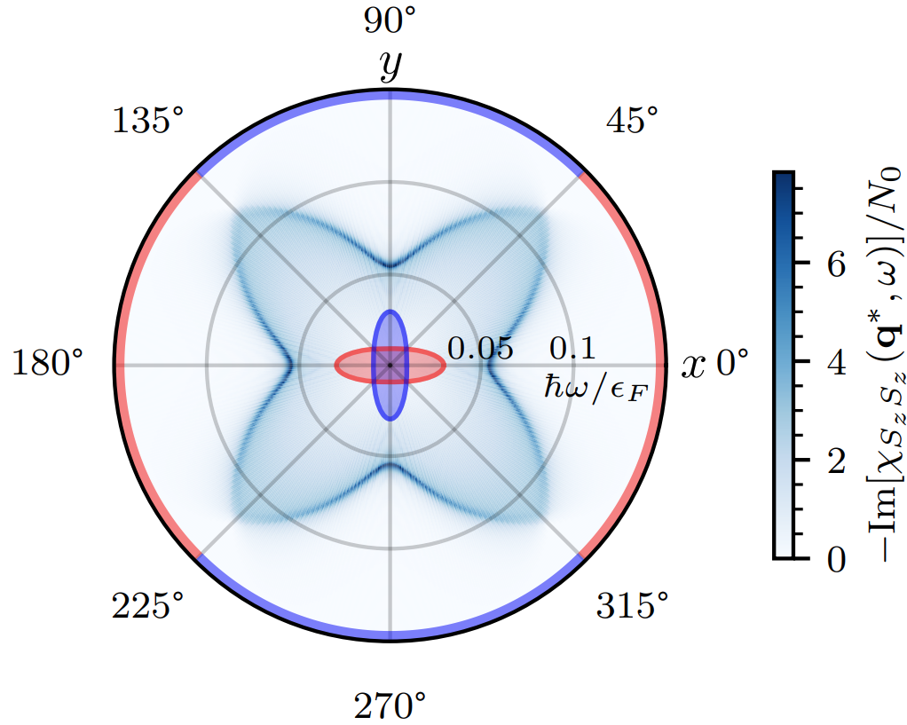

Spin demon in d-wave altermagnet
@ fixed but small$q$
Projected majority spin species

Slide 13
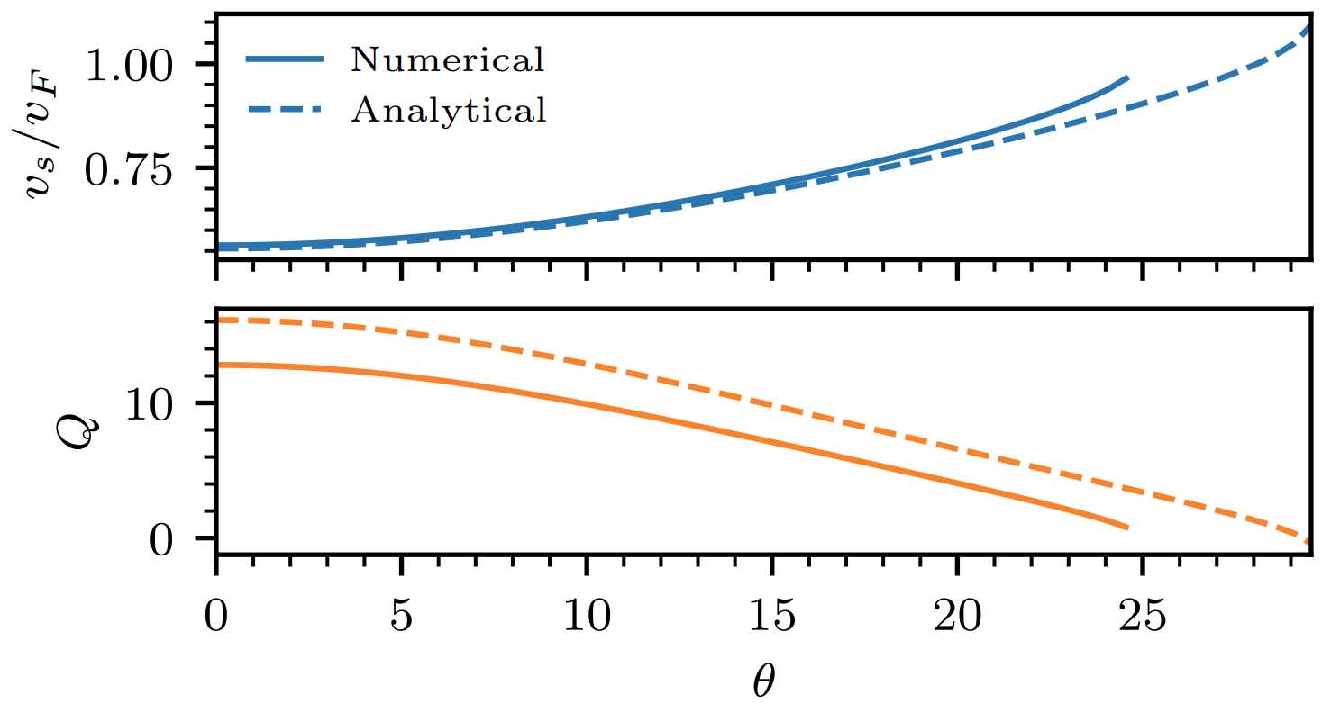
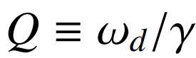
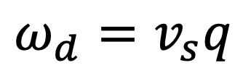
Quality factor
$$ω_{d}=v_{s}q$$
Quality factor:

Slide 14
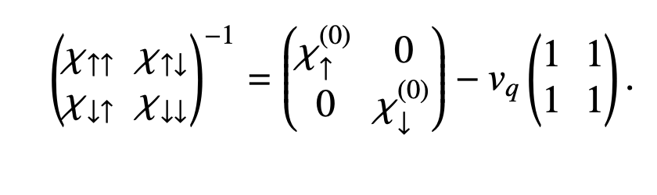
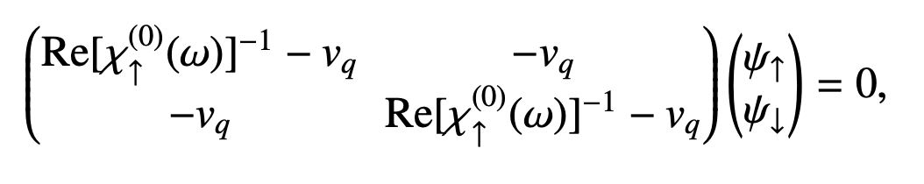
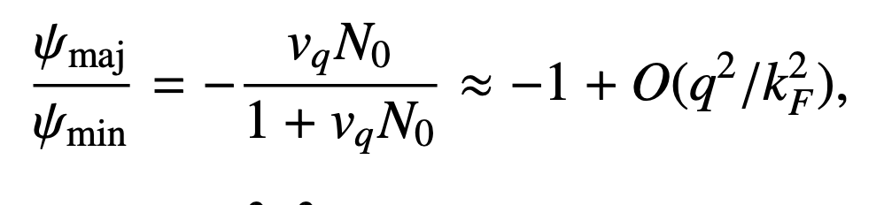
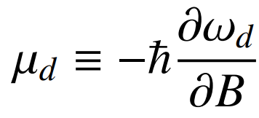
Magnetic moment
Out-of-phase oscillation of spin species
Add magnetic field along Néel vector: define a magnetic moment

Slide 15
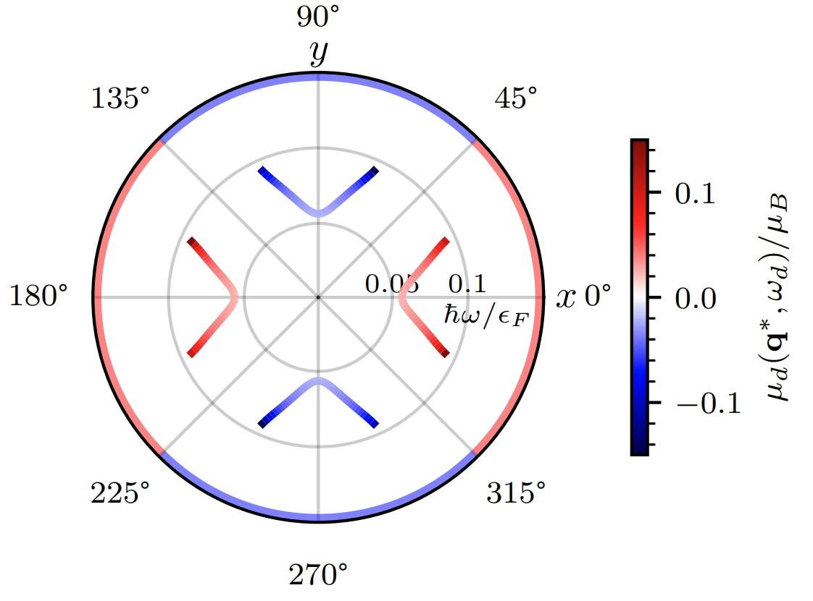
Magnetic moment
Magnetic moment:
Couples to magnetic field
(Also strain, if it couples to sublattices)

Slide 16
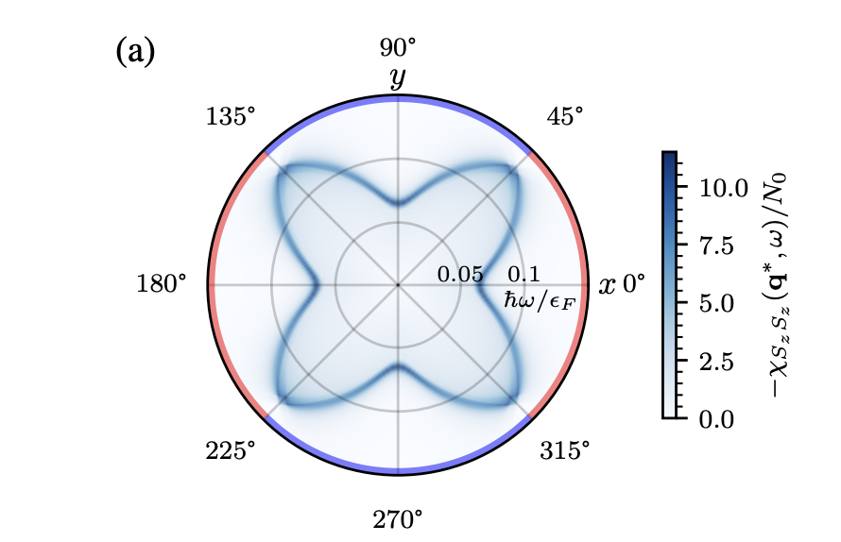
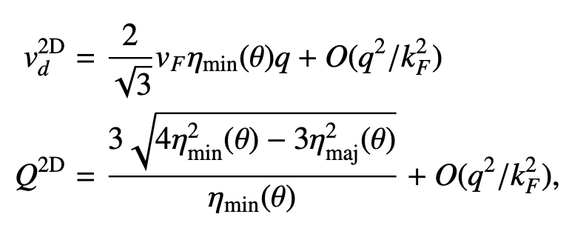
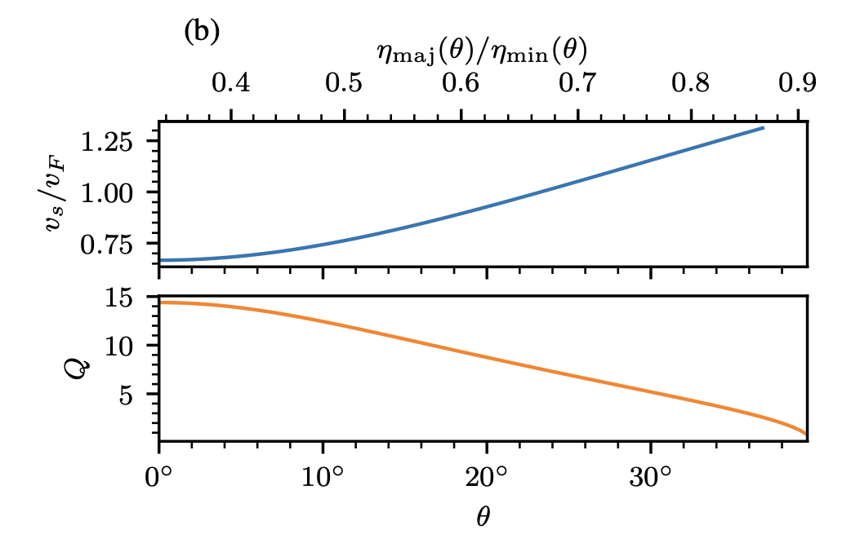
Two dimensions
Always in the spin-split plane
Exact solutions for the velocity and quality factor:
Survives for larger angles + (slightly) better quality factors

Slide 17
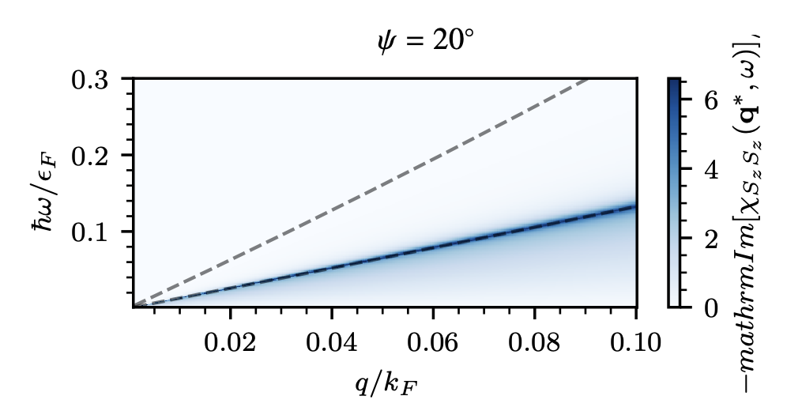
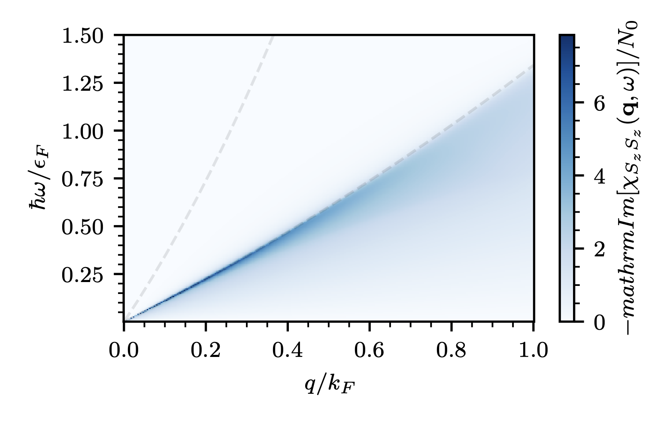
Other observations
Strongest in the spin-split plane, but not fine-tuned
Lives over long range of wave vectors
Tilted out of plane
Enters the continuum
Longer range of wave vectors

Slide 18
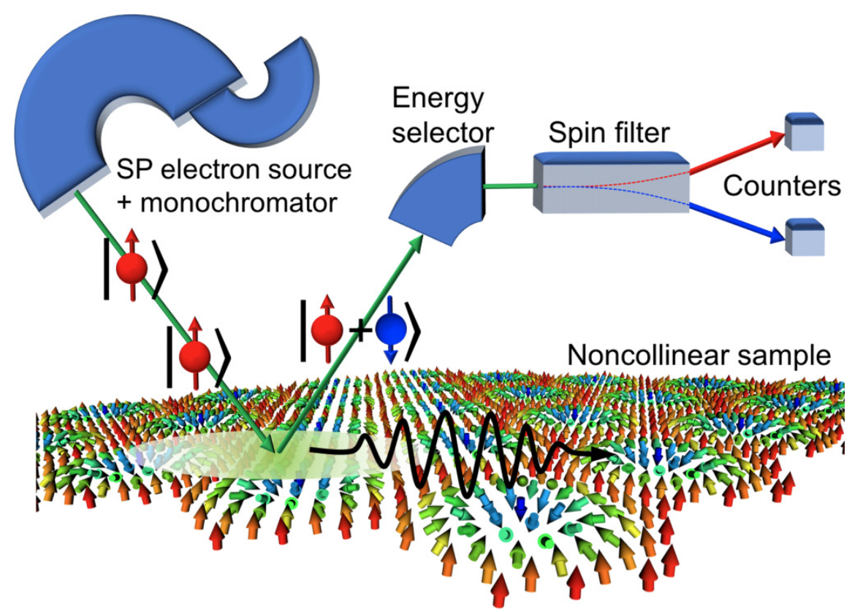
Possible detection
SPEELS
Dos Santos et al., PRB 97, 024431 (2018)

Slide 19
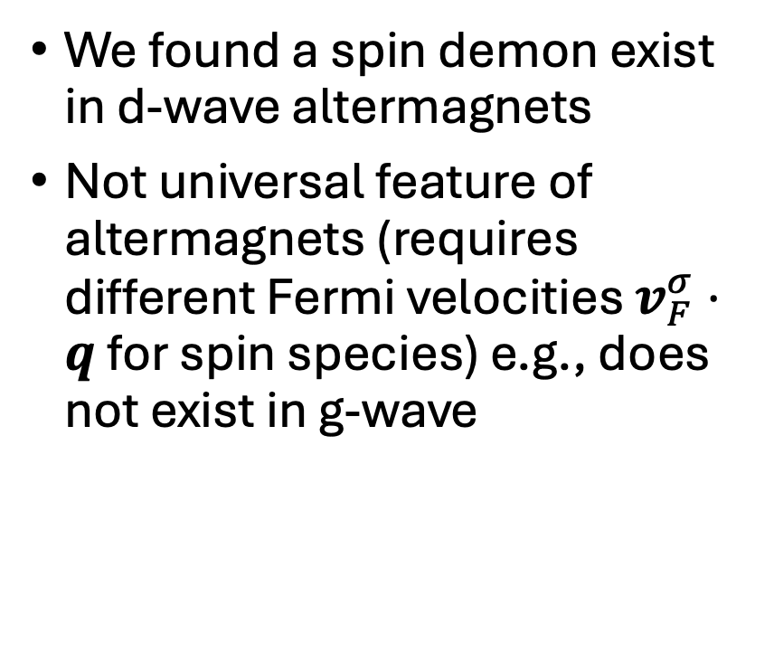
Conclusion
We found a spin demon exist in d-wave altermagnets
Not universal feature of altermagnets (requires different Fermi velocities $v_{F}^{σ}⋅q$ for spin species) e.g., does not exist in g-wave
Gunnink, Sinova, Mook, arXiv:2504.11062

